Slide 1

CONSTITUIONAL LAW & ETHICS
Faculty of Law

Slide 2
CONSTITUTIONAL law & ETHICS
UNIT 3- Cyber Law and IP Regime
Faculty of Law

Slide 3
Introduction to Intellectual Property Rights (IPR)
Definition: Legal mechanisms granting creators exclusive rights over their intangible assets
Objectives:
Promote innovation and investment in R&D
Ensure public disclosure of technical knowledge
Balance interests of creators, users, and society
Relevance to Engineering:
Protection of inventions (devices, processes)
Safeguarding software code, circuit designs, and CAD models
Commercialization: licensing, joint ventures
Quick Fact: Global R&D spending hit $2.8 trillion in 2023; strong IP regimes correlate with higher investments.

Slide 4
NATURE OF IP
Tangible vs. Intangible:
IP is intangible—no physical asset, but legally enforceable rights
Exclusive Rights:
Right to use, license, assign, and enforce
Time-bound (e.g., patents: 20 years; trademarks: 10 years renewable)
Territoriality:
Rights enforceable only within grant jurisdiction (e.g., Indian Patent Office)
Multinational filings (PCT, Madrid Protocol) for broader coverage
Example: Ownership disputes in collaborative CAD projects—Relevance of clear IP clauses in contracts

Slide 5
CYBER LAWS
Trademark
Key Functions:
Source identification
Quality assurance
Marketing & brand equity creation
DURATION – To be Renewed every 10 years
Conventional vs. Non‑Conventional Trademarks
Conventional: Words (“Nikon”), logos (Apple’s apple), shapes (Coca‑Cola bottle)
Non‑Conventional:
Sound marks (Intel), Smell Marks (play dough), Motion marks (MGM Lion), Colour marks (purple shade in Dairy milk), shape marks (Toblerone), Pattern marks, structures/ buildings (Taj Mahal Hotel, Mumbai), Fluid Trademarks (Google)

Slide 6


CYBER LAWS

Slide 7

CYBER LAWS
Copyright – Introduction
Definition: Protection of original literary, dramatic, musical, artistic works, cinematograph films, and computer programs.
Neighbouring Rights - Performer’s Rights And Broadcasting Rights
Section 13 of The Copyright Act, 1957 - Works in which copyright subsists.
Section 14 of The Copyright Act, 1957 - Meaning of Copyright

Slide 8

CYBER LAWS
Copyright – Introduction

Slide 9
CYBER LAWS
Exclusive Rights of the copyright owner
Reproduce
to issue copies of the work to the public
to perform the work in public
to make any cinematograph film or sound recording
to make any translation of the work
to make any adaptation of the work

Slide 10
CYBER LAWS
Exclusive Rights
In the case of Cinematography works, Software and Sound Recording
- to sell or give on commercial rental or offer for sale or for commercial rental any copy of the computer programme
- storing of it in any medium by electronic or other means
- a photograph of any image forming part thereof (wrt cinematography work)

Slide 11
CYBER LAWS
Protecting Software Innovation in India
Definition of Computer Program (Section 2(ff)):
"Computer programme" includes a set of instructions expressed in any form, capable of being executed by a computer.”
Criteria
Originality (Section 13):
Must be original work of the author; not copied from existing code.
Fixation in a Tangible Medium:
Source code and object code must be recorded (on a storage device) to qualify.
Author’s Identity:
Natural person or joint authorship; corporate authorship recognized if commissioned work.

Slide 12
CYBER LAWS
Registration & EXceptions
Source Code:
Human-readable code written in programming languages (e.g., C, Java, Python).
Contains comments, variable names, and is understandable by programmers.
Typically stored in text files (.c, .java, .py).
Protected as a "literary work" once fixed in a tangible medium (printed or saved).
Object Code:
Machine-readable code generated by compiling source code (binary executables, .exe, .class files).
Executable by hardware or virtual machines, not human-readable.
Not independently protected as literary work; protection derives from underlying source code but the binary format itself is considered functional output.

Slide 13
CYBER LAWS
Registration & EXceptions
Registration:
Recommended but optional;
Form XIV with a copy of code’s first and last 25 pages (computer print), along with fee.
Registration confers prima facie evidence of ownership.
Duration: 60 + Lifetime of The Author
Exceptions & Limitations (Section 52):
Fair dealing for private use, research, reverse engineering for interoperability.

Slide 14
CYBER LAWS
Artificial Intelligence and Copyright
Key Challenges at the AI–Copyright Intersection
Data Sourcing & Licensing:
Identifying proprietary vs. public-domain data in large-scale web crawls
Negotiating bulk licenses for text, code, images, audio datasets
Defining Authorship & Ownership:
Determining human vs. AI-generated contributions for copyright eligibility
Allocation of rights when multiple stakeholders (developers, data providers, users) are involved
Fair Use / Fair Dealing Ambiguities:
Lack of clear guidelines in Indian law on transformative use for model training
Risk of infringement claims for corpora including unlicensed user-generated content

Slide 15
CYBER LAWS
Artificial Intelligence and Copyright
Jurisdictional Conflicts:
Cross-border data flows vs. territorial copyright regimes, conflicting licenses
Enforcement difficulties for global AI platforms accessing Indian data
Remedy Limitations:
Difficulty in proving actual damage or attribution in AI‑generated outputs
Need for new remedy forms (statutory licensing, mandatory disclosures)

Slide 16
CYBER LAWS
Artificial Intelligence and Copyright
ANI vs. OpenAI (Delhi High Court, 2024)
Plaintiffs: Asian News International (ANI)
Allegation: Unauthorized scraping and use of newswire text/images in ChatGPT training dataset
Relief Sought: Injunction against usage of ANI content; damages for copyright infringement
Status: Interim application admitted; Hearing scheduled Q3 2025; court highlighted importance of licensing AI datasets
Authors Guild, Inc. v. OpenAI (U.S., 2023)
Plaintiffs: Group of authors and visual artists
Allegation: Unauthorized use of books, articles, and images in AI model training
Status: Ongoing; court considering whether training models constitutes "transformative use"

Slide 17
CYBER LAWS
Patents – Introduction & Criteria
Definition: Exclusive rights granted to inventors for novel inventions (product or process)
Section 2(m) of Patents Act
Key Criteria:
Novelty: Invention must be new globally (Section 2(1)(l))
Inventive Step: Non‑obvious to a person skilled in the art (Section 2(1)(ja))
Industrial Applicability: Capable of being made or used in any industry

Slide 18
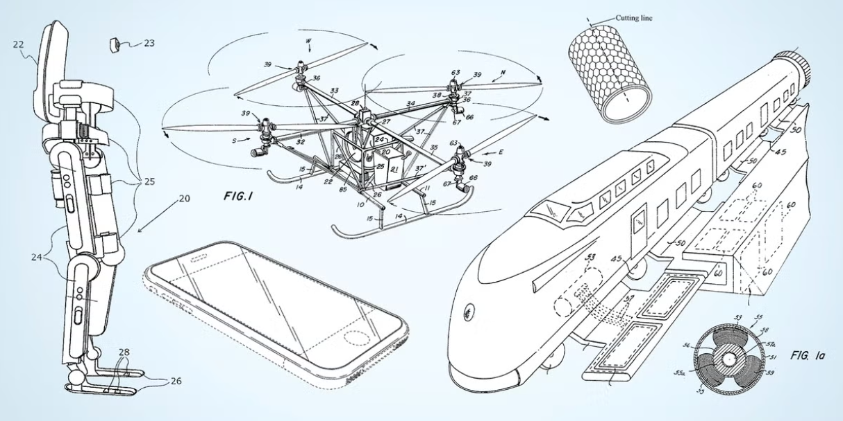
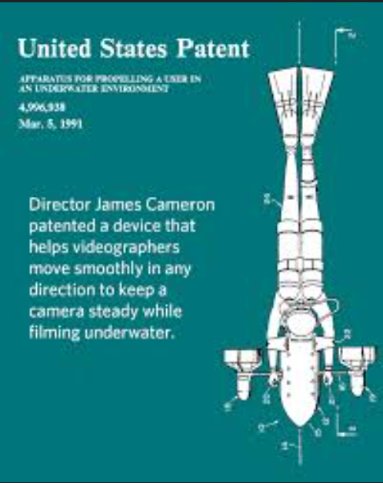
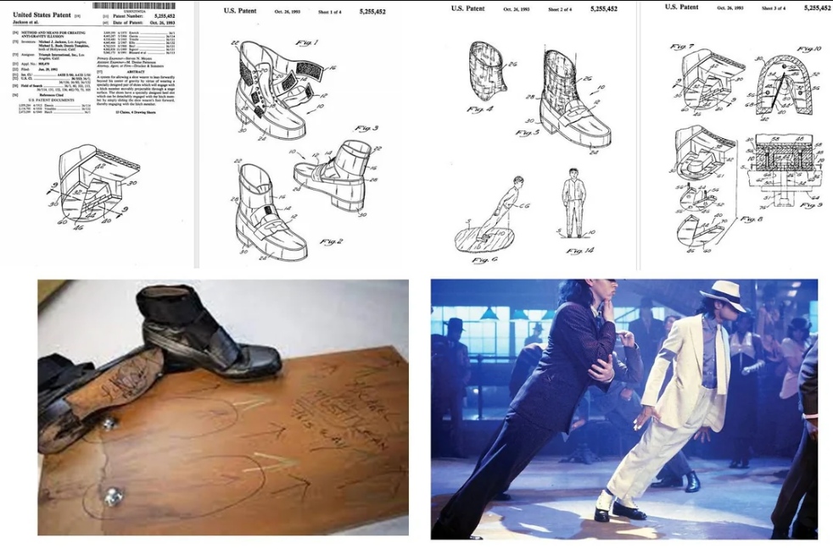
CYBER LAWS
Patents – Introduction & Criteria

Slide 19
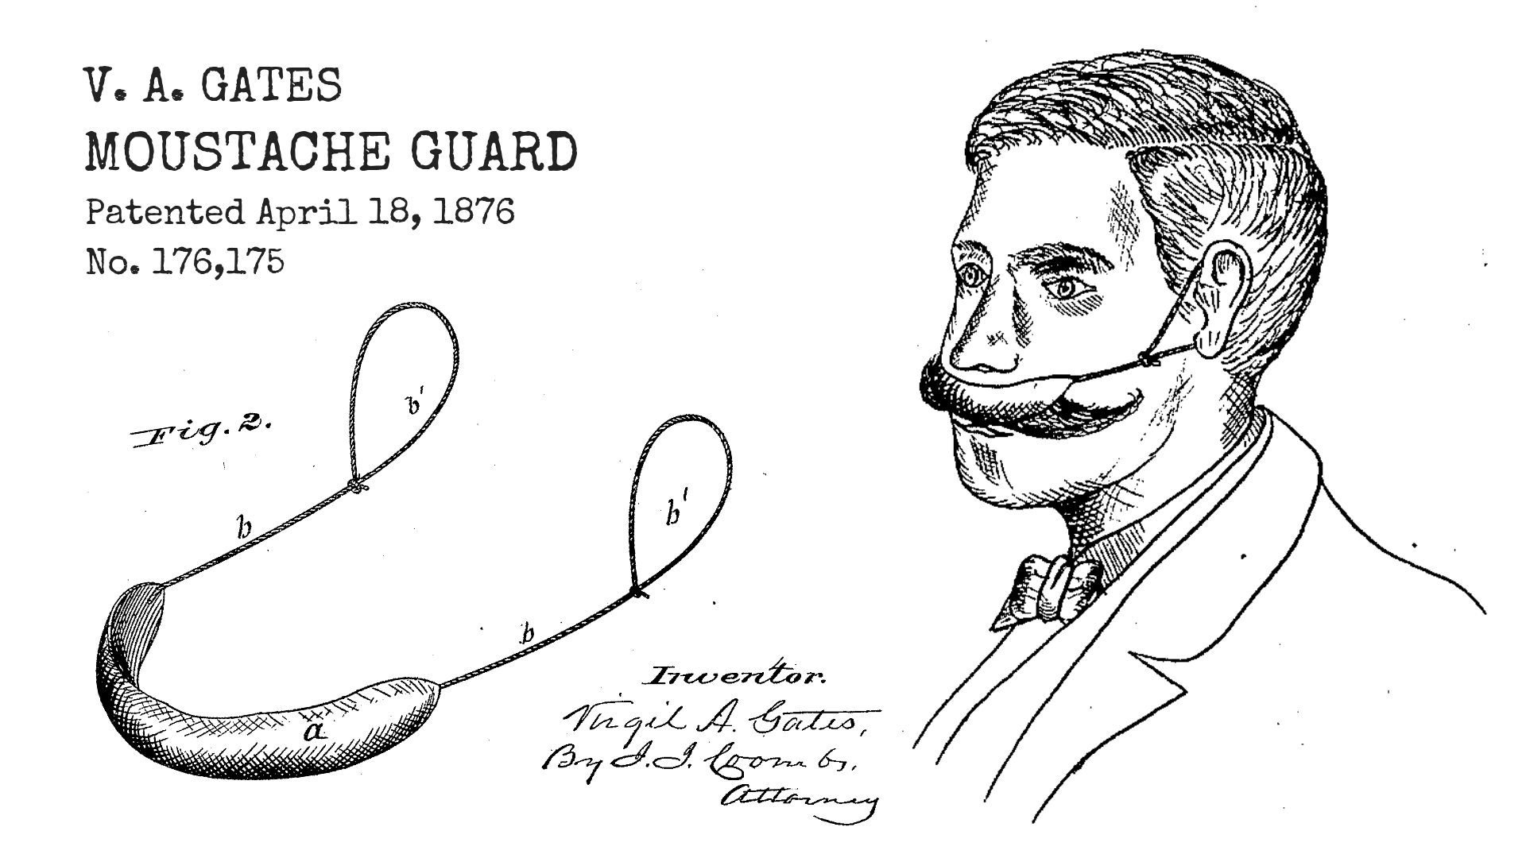
CYBER LAWS
Patents

Slide 20
CYBER LAWS
Non Patentable Inventions
Non‑Patentable Inventions (Section 3):
Frivolous or contrary to law/morality, mere discovery of scientific principle
Computer programs per se, business methods (subject to interpretation)
Term & Rights:
20 years from filing date (Section 53)
Exclusive right to prevent third parties from making, using, selling
Opposition & Revocation:
Pre‑ and post‑grant oppositions (Section 25)
Revocation on grounds of lack of novelty or inventive step
Patent Offices:
Four controllerates: Delhi, Mumbai, Chennai, Kolkata
e‑filing and expedited examination under Startup India initiative

Slide 21
CYBER LAWS
Software Patenting in India – Key Cases & Principles
Section 3(k) Exclusion:
"A mathematical or business method or a computer programme per se or algorithms" are non-patentable.
Patentable if claimed in conjunction with novel hardware or a technical application/effect.
Micromax Informatics Ltd. v. Telefonaktiebolaget LM Ericsson (2015, Delhi HC):
Court reaffirmed the need to demonstrate technical advancement; Ericsson’s patents on network-related software found valid and infringed.
Patent Office Guidelines (2017):
Clarify examination of computer-related inventions: focus on technical effect or solution to technical problems.

Slide 22
CYBER LAWS
Geographical Indications Act, 1999
Registration Process:
Application to GI Registry (Chennai)
Examination, publication, opposition
Registration valid for 10 years, renewable
Rights & Remedies:
Exclusive right to use GI tag
Civil remedies:
injunction, damages
Case Study: Basmati rice GI dispute with Pakistan—successful trilateral negotiations under WTO

Slide 23

CYBER LAWS
Geographical Indications Act, 1999

Slide 24
CYBER LAWS
Geographical Indications
The Geographical Indications of Goods (Registration and Protection) Act
Infringement
Injunction
Damages
Delivery of the infringing labels and indications containing products
Criminal remedies

Slide 25
CYBER LAWS
WIPO & Geographical Indications
International Framework:
TRIPS Agreement: Minimum GI protection standards
Geneva Act (2015) of the Lisbon Agreement: International registration
India’s Participation:
TRIPS signatory since 1995
Observer status in Lisbon system
Benefits:
Market access, protection against misappropriation
Technology transfer opportunities for local producers

Slide 26
CYBER LAWS
Traditional Knowledge – Introduction
Definition:
Collective, traditional practices, expressions, and innovations of indigenous communities
Biomimetic design inspired by indigenous architecture (e.g., termite mound cooling systems)
Traditional water harvesting techniques for sustainable engineering projects
Purpose: Prevent wrongful patents on traditional formulations and processes
Features:
Database of 400K+ formulations in Ayurveda, Unani, Siddha
Translated into English, French, German to assist patent examiners

Slide 27
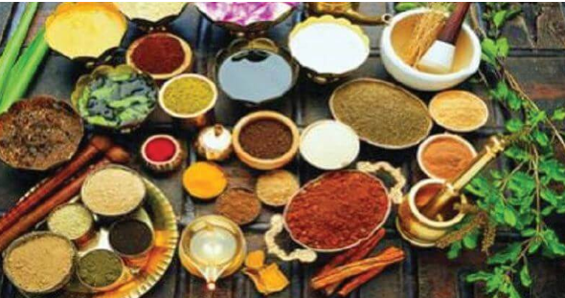
CYBER LAWS
Traditional Knowledge Digital Library (TKDL)

Slide 28
CYBER LAWS
Traditional Knowledge
Background:
Neem (Azadirachta indica) long used in Indian agriculture for its pesticidal properties
1994: U.S. Patent No. 5,436,150 granted to W.R. Grace et al. for a "Neem-based fungicidal composition“
Opposition & Revocation:
1995: Indian Council of Scientific and Industrial Research (CSIR) and NGOs filed opposition at European Patent Office (EPO)
2000: EPO revokes European equivalent patent (EP 0 469 289) citing lack of novelty and inventive step in light of traditional use
Key Lessons:
Importance of prior art research in traditional knowledge databases (TKDL)
Role of collective action by public institutions and NGOs in protecting indigenous knowledge

Slide 29
CYBER LAWS
Industrial Design – Introduction
Definition: Protection of aesthetic features (shape, configuration, ornamentation) of articles
Importance:
Enhances product appeal and marketability
Complements technical patents
Engineering Examples:
Ergonomic design of a drone controller
Aesthetic casing for consumer electronics
Registration Requirements:
Novel, original design not disclosed before application
Not purely functional: aesthetic appeal must be primary

Slide 30
CYBER LAWS
Industrial Design
Design Act of 2000
10 years
Infringement
Injunction
Damages
Criminal Prosecution

Slide 31
CYBER LAWS
Infringement & Remedies
Infringement Types:
Unauthorized manufacture, sale, import, distribution
Civil Remedies:
Interim & permanent injunctions
Damages or account of profits
Criminal Remedies:
Fines up to ₹2 lakhs, imprisonment up to 3 years (Copyright Act)
Case Study: Qualcomm vs. Micromax (2016)—Delhi HC injunction & cross‑licensing settlement

